Slide 1
Software Development with UML and Java 2

Slide 2
Agenda
Adding networking to our MVVM

Slide 3
MVVM
Networking
Client
For now, we’ll use Sockets, later we’ll use RMI
Server

Slide 4
MVVM
We want to use the MVVM on the client side, and attach to it some Networking functionality
Networ-king
Server

Slide 5
Two approaches
MVVM
The Model can have a reference to the Client-class
The Client-class can listen to the Model
Networ-king
Detailed explanation
Server

Slide 6
Two approaches
MVVM
The Model can have a reference to the Client-class
The Client-class can listen to the Model
Networ-king
Quick description, self study. Very similar structure
Server

Slide 7
Two approaches
MVVM
The Model can have a reference to the Client-class
The Client-class can listen to the Model
Networ-king
Will create a bi-directional dependency. Usually a bad approach
Will create a one-directional dependency. Usually a better approach
Server

Slide 8
UML, bidirectional dependency, Model <-> Client

Slide 9
View
FXML
FXML
FXML
View1
View2
View3
Networking
View model
ViewModel1
ViewModel2
ViewModel3
<<Model>>
Model
DataModel

Slide 10
FXML
View1
Networking
<<Client>>
ViewModel1
SocketClient
<<Model>>
DataModel

Slide 11
FXML
View1
ViewModel1
<<Client>>
SocketClient
<<Model>>
DataModel

Slide 12
FXML
View1
<<Runnable>>
ViewModel1
SSocketHandler
<<Client>>
SocketClient
SocketServer
<<Model>>
DataModel

Slide 13
FXML
View1
<<Runnable>>
ViewModel1
SSocketHandler
<<Client>>
<<Runnable>>
SocketClient
CSocketHandler
SocketServer
<<Model>>
DataModel

Slide 14
FXML
View1
ViewModel1
<<Runnable>>
<<Client>>
<<Runnable>>
SSocketHandler
SocketClient
CSocketHandler
<<Model>>
SocketServer
DataModel

Slide 15
FXML
View1
ViewModel1
<<Runnable>>
<<Client>>
<<Runnable>>
SSocketHandler
SocketClient
CSocketHandler
<<Model>>
SocketServer
ServerModel
DataModel

Slide 16


Slide 17
Task list example
Demo

Slide 18
FXML
FXML
Adding a new task
AddView
ListView
AddVM
ListVM
<<Runnable>>
<<Client>>
<<Runnable>>
SSocketHandler
SocketClient
CSocketHandler
<<Model>>
SocketServer
ServerModel
DataModel

Slide 19
Other client
FXML
FXML
Adding a new task
Info about Owner and description inserted into TextField
<<Model>>
<<Client>>
<<Runnable>>
AddView
ListView
DataModel
SocketClient
CSocketHandler
AddVM
ListVM
<<Runnable>>
<<Client>>
<<Runnable>>
SSocketHandler
SocketClient
CSocketHandler
<<Model>>
SocketServer
ServerModel
DataModel

Slide 20
FXML
FXML
Adding a new task
Data inserted into Properties, reflected to the View Model
<<Model>>
<<Client>>
AddView
ListView
DataModel
SocketClient
CSocketHandler
AddVM
ListVM
<<Runnable>>
<<Client>>
<<Runnable>>
SSocketHandler
SocketClient
CSocketHandler
<<Model>>
SocketServer
ServerModel
DataModel

Slide 21
FXML
FXML
Adding a new task
Click Save button
<<Model>>
<<Client>>
AddView
ListView
DataModel
SocketClient
CSocketHandler
AddVM
ListVM
<<Runnable>>
<<Client>>
<<Runnable>>
SSocketHandler
SocketClient
CSocketHandler
<<Model>>
SocketServer
ServerModel
DataModel

Slide 22
FXML
FXML
Adding a new task
Logic performed here, owner and description sent to model
<<Model>>
<<Client>>
AddView
ListView
DataModel
SocketClient
CSocketHandler
AddVM
ListVM
<<Runnable>>
<<Client>>
<<Runnable>>
SSocketHandler
SocketClient
CSocketHandler
<<Model>>
SocketServer
ServerModel
DataModel

Slide 23
FXML
FXML
Adding a new task
Model puts the info into a Task object, adds to list.
<<Model>>
<<Client>>
AddView
ListView
DataModel
SocketClient
CSocketHandler
AddVM
ListVM
<<Runnable>>
<<Client>>
<<Runnable>>
SSocketHandler
SocketClient
CSocketHandler
<<Model>>
SocketServer
ServerModel
DataModel

Slide 24
FXML
FXML
Adding a new task
Model notifies listeners about the added task
<<Model>>
<<Client>>
AddView
ListView
DataModel
SocketClient
CSocketHandler
AddVM
ListVM
<<Runnable>>
<<Client>>
<<Runnable>>
SSocketHandler
SocketClient
CSocketHandler
<<Model>>
SocketServer
ServerModel
DataModel

Slide 25
FXML
FXML
Adding a new task
Model sends new Task to client
<<Model>>
<<Client>>
AddView
ListView
DataModel
SocketClient
CSocketHandler
AddVM
ListVM
<<Runnable>>
<<Client>>
<<Runnable>>
SSocketHandler
SocketClient
CSocketHandler
<<Model>>
SocketServer
ServerModel
DataModel

Slide 26
FXML
FXML
Adding a new task
Client sends the Task to the server Model
<<Model>>
<<Client>>
AddView
ListView
DataModel
SocketClient
CSocketHandler
AddVM
ListVM
<<Runnable>>
<<Client>>
<<Runnable>>
SSocketHandler
SocketClient
CSocketHandler
<<Model>>
SocketServer
ServerModel
DataModel

Slide 27
FXML
FXML
Adding a new task
ServerModel notifies SocketHandlers
<<Model>>
<<Client>>
AddView
ListView
DataModel
SocketClient
CSocketHandler
AddVM
ListVM
<<Runnable>>
<<Client>>
<<Runnable>>
SSocketHandler
SocketClient
CSocketHandler
<<Model>>
SocketServer
ServerModel
DataModel

Slide 28
FXML
FXML
Adding a new task
<<Model>>
<<Client>>
AddView
ListView
DataModel
SocketClient
CSocketHandler
SocketHandlers sends the new Task to all connected clients
AddVM
ListVM
<<Runnable>>
<<Client>>
<<Runnable>>
SSocketHandler
SocketClient
CSocketHandler
<<Model>>
SocketServer
ServerModel
DataModel

Slide 29
FXML
FXML
Adding a new task
<<Model>>
<<Client>>
AddView
ListView
DataModel
SocketClient
CSocketHandler
Client adds the new Task to the client-side Model
AddVM
ListVM
<<Runnable>>
<<Client>>
<<Runnable>>
SSocketHandler
SocketClient
CSocketHandler
<<Model>>
SocketServer
ServerModel
DataModel

Slide 30
FXML
FXML
Adding a new task
<<Model>>
<<Client>>
AddView
ListView
DataModel
SocketClient
CSocketHandler
Model notifies about added Task
AddVM
ListVM
<<Runnable>>
<<Client>>
<<Runnable>>
SSocketHandler
SocketClient
CSocketHandler
<<Model>>
SocketServer
ServerModel
DataModel

Slide 31
FXML
FXML
Adding a new task
<<Model>>
<<Client>>
AddView
ListView
DataModel
SocketClient
CSocketHandler
List View Model updates its data
List View Model updates its data
AddVM
ListVM
<<Runnable>>
<<Client>>
<<Runnable>>
SSocketHandler
SocketClient
CSocketHandler
<<Model>>
SocketServer
ServerModel
DataModel

Slide 32
FXML
FXML
Adding a new task
<<Model>>
<<Client>>
AddView
ListView
DataModel
SocketClient
CSocketHandler
A Task from one client-program is thus sent to all other connected client-programs
AddVM
ListVM
<<Runnable>>
<<Client>>
<<Runnable>>
SSocketHandler
SocketClient
CSocketHandler
<<Model>>
SocketServer
ServerModel
DataModel

Slide 34
FXML
FXML
Code
Not much functionality besides sending data
AddView
ListView
AddVM
ListVM
<<Runnable>>
<<Client>>
<<Runnable>>
SSocketHandler
SocketClient
CSocketHandler
<<Model>>
SocketServer
ServerModel
DataModel

Slide 35
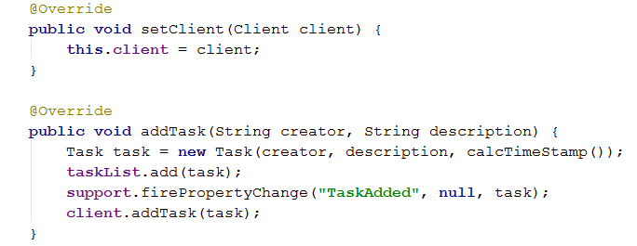
FXML
FXML
Code
AddView
ListView
AddVM
ListVM
<<Runnable>>
<<Client>>
<<Runnable>>
SSocketHandler
SocketClient
CSocketHandler
<<Model>>
SocketServer
ServerModel
DataModel

Slide 36
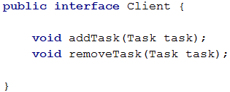
FXML
FXML
Code
AddView
ListView
AddVM
ListVM
<<Runnable>>
<<Client>>
<<Runnable>>
SSocketHandler
SocketClient
CSocketHandler
<<Model>>
SocketServer
ServerModel
DataModel

Slide 37
TaskListModel model; ClientSocketHandler socketHandler; public SocketClient (TaskListModel _model) { model = _model; model.setClient(this); try { Socket socket = new Socket("localhost", 2910); socketHandler = new ClientSocketHandler( new ObjectOutputStream(socket.getOutputStream()), new ObjectInputStream(socket.getInputStream()), this); Thread t = new Thread(socketHandler); t.start(); } catch (IOException e) { e.printStackTrace(); } } public void addToClientModel(Task task) { model.addTask(task); } public void removeFromClientModel(Task task) { model.removeTask(task); } @Override public void addTask(Task task) { socketHandler.addTaskToServer(task); } @Override public void removeTask(Task task) { socketHandler.removeTaskFromServer(task); }
FXML
FXML
AddView
ListView
AddVM
ListVM
<<Runnable>>
<<Client>>
<<Runnable>>
SSocketHandler
SocketClient
CSocketHandler
<<Model>>
SocketServer
ServerModel
DataModel

Slide 38
TaskListModel model; ClientSocketHandler socketHandler; public SocketClient (TaskListModel _model) { model = _model; model.setClient(this); try { Socket socket = new Socket("localhost", 2910); socketHandler = new ClientSocketHandler( new ObjectOutputStream(socket.getOutputStream()), new ObjectInputStream(socket.getInputStream()), this); Thread t = new Thread(socketHandler); t.start(); } catch (IOException e) { e.printStackTrace(); } } public void addToClientModel(Task task) { model.addTask(task); } public void removeFromClientModel(Task task) { model.removeTask(task); } @Override public void addTask(Task task) { socketHandler.addTaskToServer(task); } @Override public void removeTask(Task task) { socketHandler.removeTaskFromServer(task); }
FXML
FXML
AddView
ListView
AddVM
ListVM
<<Runnable>>
<<Client>>
<<Runnable>>
SSocketHandler
SocketClient
CSocketHandler
<<Model>>
SocketServer
ServerModel
DataModel

Slide 39
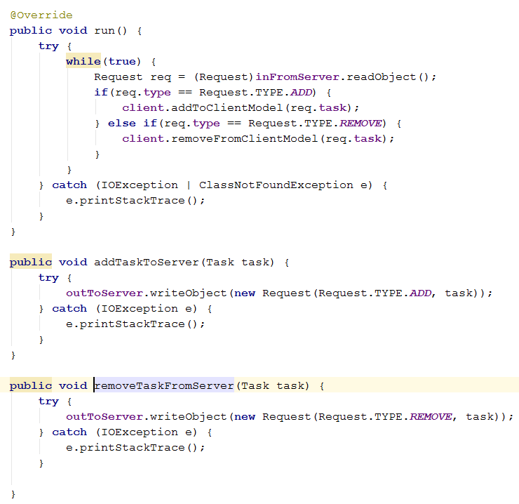
FXML
FXML
AddView
ListView
AddVM
ListVM
<<Runnable>>
<<Client>>
<<Runnable>>
SSocketHandler
SocketClient
CSocketHandler
<<Model>>
SocketServer
ServerModel
DataModel

Slide 40
FXML
FXML
AddView
ListView
AddVM
ListVM
<<Runnable>>
<<Client>>
<<Runnable>>
SSocketHandler
SocketClient
CSocketHandler
<<Model>>
SocketServer
ServerModel
DataModel

Slide 41
public ServerSocketHandler(Socket socket, ServerModel model) { this.socket = socket; this.model = model; try { outToClient = new ObjectOutputStream(socket.getOutputStream()); inFromClient = new ObjectInputStream(socket.getInputStream()); } catch (IOException e) { e.printStackTrace(); } model.addListener("TaskAdded", this::addTask); model.addListener("TaskRemoved", this::removeTask); }
@Override public void run() { try { while(true) { Request req = (Request) inFromClient.readObject(); if(req.type == Request.TYPE.ADD) { model.addTask(req.task); } else if (req.type == Request.TYPE.REMOVE){ model.taskRemoved(req.task); } } } catch (IOException | ClassNotFoundException e) { e.printStackTrace(); } } private void addTask(PropertyChangeEvent evt) { try { Request req = new Request(Request.TYPE.ADD, (Task) evt.getNewValue()); outToClient.writeObject(req); } catch (IOException e) { e.printStackTrace(); } } private void removeTask(PropertyChangeEvent evt) { try { Request req = new Request(Request.TYPE.REMOVE, (Task) evt.getNewValue()); outToClient.writeObject(req); } catch (IOException e) { e.printStackTrace(); } }
FXML
FXML
AddView
ListView
AddVM
ListVM
<<Runnable>>
<<Client>>
<<Runnable>>
SSocketHandler
SocketClient
CSocketHandler
<<Model>>
SocketServer
ServerModel
DataModel

Slide 42
public ServerSocketHandler(Socket socket, ServerModel model) { this.socket = socket; this.model = model; try { outToClient = new ObjectOutputStream(socket.getOutputStream()); inFromClient = new ObjectInputStream(socket.getInputStream()); } catch (IOException e) { e.printStackTrace(); } model.addListener("TaskAdded", this::addTask); model.addListener("TaskRemoved", this::removeTask); }
@Override public void run() { try { while(true) { Request req = (Request) inFromClient.readObject(); if(req.type == Request.TYPE.ADD) { model.addTask(req.task); } else if (req.type == Request.TYPE.REMOVE){ model.taskRemoved(req.task); } } } catch (IOException | ClassNotFoundException e) { e.printStackTrace(); } } private void addTask(PropertyChangeEvent evt) { try { Request req = new Request(Request.TYPE.ADD, (Task) evt.getNewValue()); outToClient.writeObject(req); } catch (IOException e) { e.printStackTrace(); } } private void removeTask(PropertyChangeEvent evt) { try { Request req = new Request(Request.TYPE.REMOVE, (Task) evt.getNewValue()); outToClient.writeObject(req); } catch (IOException e) { e.printStackTrace(); } }
FXML
FXML
AddView
ListView
AddVM
ListVM
<<Runnable>>
<<Client>>
<<Runnable>>
SSocketHandler
SocketClient
CSocketHandler
<<Model>>
SocketServer
ServerModel
DataModel

Slide 43
public ServerSocketHandler(Socket socket, ServerModel model) { this.socket = socket; this.model = model; try { outToClient = new ObjectOutputStream(socket.getOutputStream()); inFromClient = new ObjectInputStream(socket.getInputStream()); } catch (IOException e) { e.printStackTrace(); } model.addListener("TaskAdded", this::addTask); model.addListener("TaskRemoved", this::removeTask); }
@Override public void run() { try { while(true) { Request req = (Request) inFromClient.readObject(); if(req.type == Request.TYPE.ADD) { model.addTask(req.task); } else if (req.type == Request.TYPE.REMOVE){ model.taskRemoved(req.task); } } } catch (IOException | ClassNotFoundException e) { e.printStackTrace(); } } private void addTask(PropertyChangeEvent evt) { try { Request req = new Request(Request.TYPE.ADD, (Task) evt.getNewValue()); outToClient.writeObject(req); } catch (IOException e) { e.printStackTrace(); } } private void removeTask(PropertyChangeEvent evt) { try { Request req = new Request(Request.TYPE.REMOVE, (Task) evt.getNewValue()); outToClient.writeObject(req); } catch (IOException e) { e.printStackTrace(); } }
FXML
FXML
AddView
ListView
AddVM
ListVM
<<Runnable>>
<<Client>>
<<Runnable>>
SSocketHandler
SocketClient
CSocketHandler
<<Model>>
SocketServer
ServerModel
DataModel

Slide 44
FXML
FXML
List<Task> taskList; private PropertyChangeSupport support = new PropertyChangeSupport(this); public ServerModel() { taskList = new ArrayList<>(); } public void taskRemoved(Task task) { taskList.remove(task); support.firePropertyChange("TaskRemoved", null, task); }
public void addListener(String eventName, PropertyChangeListener listener) { if(eventName == null || "".equals(eventName)) { support.addPropertyChangeListener(listener); } else { support.addPropertyChangeListener(eventName, listener); } } public void addTask(Task task) { taskList.add(task); support.firePropertyChange("TaskAdded", null, task); }
AddView
ListView
AddVM
ListVM
<<Runnable>>
<<Client>>
<<Runnable>>
SSocketHandler
SocketClient
CSocketHandler
<<Model>>
SocketServer
ServerModel
DataModel

Slide 45
List<Task> taskList; private PropertyChangeSupport support = new PropertyChangeSupport(this); public ServerModel() { taskList = new ArrayList<>(); } public void taskRemoved(Task task) { taskList.remove(task); support.firePropertyChange("TaskRemoved", null, task); }
public void addListener(String eventName, PropertyChangeListener listener) { if(eventName == null || "".equals(eventName)) { support.addPropertyChangeListener(listener); } else { support.addPropertyChangeListener(eventName, listener); } } public void addTask(Task task) { taskList.add(task); support.firePropertyChange("TaskAdded", null, task); }
FXML
FXML
AddView
ListView
AddVM
ListVM
<<Runnable>>
<<Client>>
<<Runnable>>
SSocketHandler
SocketClient
CSocketHandler
<<Model>>
SocketServer
ServerModel
DataModel

Slide 46
public class Request implements Serializable { public enum TYPE { ADD, REMOVE } public TYPE type; public Task task; public Request(TYPE type, Task task) { this.type = type; this.task = task; } }
FXML
FXML
AddView
ListView
AddVM
ListVM
<<Runnable>>
<<Client>>
<<Runnable>>
SSocketHandler
SocketClient
CSocketHandler
<<Model>>
SocketServer
ServerModel
DataModel

Slide 47


Slide 48
Observing the Client Model
The Model doesn’t know anything about any Client.
Whenever a task is added to the model, all listeners are notified.
The Client will listen, and upon such a notification it will send the Task to the Server side, which will propagate the Task to other connected Clients.
If the Model needs something from the Server, retrieve some data or similar, it will fire a “Request” event, with the relevant information.
When the client receives such a notification, it will send a request to the Server, and then update the Model with the response. The Model will then notify interested View Models about the change.

Slide 49
FXML
FXML
AddView
ListView
AddVM
ListVM
<<Runnable>>
<<Client>>
<<Runnable>>
SSocketHandler
SocketClient
CSocketHandler
<<Model>>
SocketServer
ServerModel
Fire notifications
DataModel

Slide 50


Slide 51


